Slide 1

Competitive Landscape Analysis
Team 6:
Vraj Deriya
Riyazul Ansari
Sai Kiran Billa
Mihika Bodke
Yvonne Yang

Slide 2

Agenda
Background & Problem Statement
Analytical Framework Overview
Analysis
Conclusion
Overview of Walmart’s current customer experience challenges and project focus.
Outline of the models used to analyze Walmart’s position and competitive environment.
Key findings from internal and external assessments of Walmart’s competitiveness.
Summary of major insights

Slide 3
Background
Walmart is rapidly transforming through growth in e-commerce, advertising.
In FY2024, it generated $648B in revenue; Walmart Connect ad sales exceeded $3B.
E-commerce penetration reached 15.9% of U.S. retail sales, almost 3× pre-pandemic levels.
Walmart faces rising pressures from:
Retail theft and operational losses (~$112B, 2022–23)
Inflation-driven trade-downs to private labels
Supply chain and labor challenges
Intensifying competition from Amazon, Shein, and quick-commerce players
Customer expectations are shifting:
88% demand personalization
61% are open to AI-powered retail tools
AI is now a near-term strategic priority essential for improving efficiency, personalization, and customer satisfaction in an increasingly competitive market.

Slide 4
Problem Statement
How can Walmart utilize AI to enhance customer
experience and maintain competitiveness in the U.S. market?
To enhance customer experience, we will be focusing on the following areas:
Walmart continues to face recurring customer issues despite its scale. Empty shelves, long checkout times, and a less personalized online experience reduce satisfaction and loyalty.
Walmart’s customer satisfaction score is about 70, compared to Costco and Target, both of which are closer to 80.
With competitors improving their service and new quick-commerce options raising expectations for speed and convenience. Walmart can address these gaps using Artificial Intelligence.
01
02
03
Customer
retention
Customer acquisition
Personalization experiences

Slide 5

A multi-framework approach
SWOT + Three of Porter’s Five Forces Model
Weaknesses
Opportunities
Identify internal limitations and customer pain points in Walmart’s digital and in-store experiences, highlighting where AI adoption and integration remain limited.
Explore emerging AI trends and innovations in retail that Walmart can leverage to enhance personalization, retention, and omnichannel customer engagement.
Strengths
Threats
Assess Walmart’s internal capabilities scale, customer data, technology, and omnichannel reach that enable AI-driven customer personalization and loyalty improvement.
Analyze Walmart’s external pressures using Porter’s Three Forces competitor rivalry, buyer power, and substitutes to understand challenges in sustaining competitive advantage.

Slide 6

Strengths

Slide 7
AI-Driven Scale and Data Synergy: Walmart’s Competitive Flywheel
AI-DRIVEN STRENGTHS IN CX AND PERSONALIZATION
AI ADVANTAGES – SCALE, OMNICHANNEL, AND DATA
WALMART CONNECT + GLOBAL TECH FLYWHEEL
Walmart’s Data and Scale Advantage
Scale and Data Flywheel
Ecosystem Synergy and Strategic Implications
Serves over 240 million customers weekly across more than 10,500 stores worldwide and online platforms.
Possesses one of the largest labeled retail datasets globally, driving deep AI-powered customer insights and operational optimizations.
Walmart’s mission: "From transactions to deep customer understanding," reflecting its focus on personalized experiences.
Integrated AI models combine in-store and online customer behaviors to create a comprehensive 360° customer view, surpassing ecommerce-only competitors.
AI-driven replenishment system predicts SKU-level demand using real-time data from stores, distribution centers, and external factors like weather.
Omnichannel integration turns stores into both fulfillment hubs and data capture sensors, establishing a powerful reinforcement loop.
Generative AI search interprets intent-based queries such as "family pizza night," enhancing the customer experience through intuitive digital discovery.
Walmart Connect converts real-time shopping and loyalty data into AI-optimized ad targeting, driving a 30% year-over-year increase in ad revenue.
Walmart Global Tech employs over 30,000 technologists focused on R&D initiatives that improve product search relevance and speed.
Generative AI prototypes include Smart Assistant for associates and shopping/planning tools for customers, scaling AI applications.
Strategic advantage lies in the closed-loop data system combined with Walmart’s ability to deploy solutions at scale, accelerating model learning and monetization synergy.

Slide 8

Weaknesses

Slide 9
Weaknesses in AI Adoption and Customer Experience
Walmart’s AI adoption is fragmented and primarily focused on operational efficiency rather than meeting customer needs.
Limited personalization compared to Amazon and Target; product suggestions are repetitive and lack context.
Customers find the app and website plain and less interactive.
Satisfaction score is around 70, while Costco and Target are close to 80.
01
02
03
Internal Gaps in AI Adoption and Customer Understanding
Persistent Pain Points Impacting Satisfaction and Loyalty
Organizational Challenges Slowing AI Transformation

Slide 10
Key Customer Pain Points
Self checkout errors and long wait times continue to frustrate customers.
Stockouts and inaccurate restocking reduce convenience and trust.
Online experience lacks real time personalization and smooth connection across platforms.
App navigation and search tools are weaker than those of Amazon and Target.
Customers see Walmart as convenient but not inspiring or emotionally engaging.
01
02
03
Internal Gaps in AI Adoption and Customer Understanding
Persistent Pain Points Impacting Satisfaction and Loyalty
Organizational Challenges Slowing AI Transformation

Slide 11
Internal and Cultural Barriers
Data is scattered across stores, websites, and apps, limiting unified customer profiles.
Older systems and slow innovation restrict progress.
Employees have limited AI training and remain cautious about automation.
The company culture still focuses on cost control rather than fast experimentation.
01
02
03
Internal Gaps in AI Adoption and Customer Understanding
Persistent Pain Points Impacting Satisfaction and Loyalty
Organizational Challenges Slowing AI Transformation

Slide 12

Opportunities

Slide 13
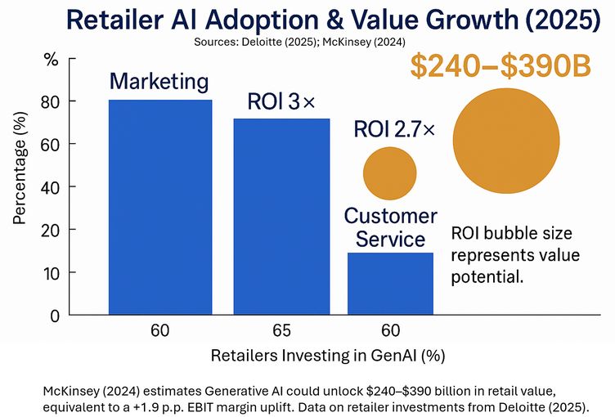
AI Is Redefining Retail Experiences: A $300B Opportunity
Consumer Demand for AI Shopping
Retailers Scaling GenAI for Growth
53% of U.S. consumers plan to use GenAI in 2025 (eMarketer)
75% feel comfortable with AI recommendations (Capgemini)
61% already use AI tools like ChatGPT or “Rufus” (eMarketer)
AI adoption is moving from trial to mainstream.
97% plan to expand AI investment (Deloitte)
Avg ROI 2.7–3× within one year (Deloitte)
AI could unlock $240–390B in retail value (McKinsey)
Retailers are capturing value through marketing, e-commerce, and service.
Global Adoption and Market Growth Trends

Slide 14

Global AI Best Practices Enhancing CX & Loyalty
Industry Momentum
AI shopping tools now drive up to 700% higher conversions than social media referrals.
21% of Walmart’s referral traffic now originates from AI platforms like ChatGPT.
Retailers worldwide are accelerating AI deployment to meet growing consumer expectations.
Retailers | AI Initiative | Customer Impact | Implications for Walmart
Amazon | Rufus chatbot & Lens Live AI search | Real-time discovery & product guidance | Benchmark for AI-first CX; closed ecosystem limits reach
Walmart | Sparky agent + OpenAI ChatGPT partnership | Seamless “agentic commerce” & voice-based shopping | First-mover in open AI ecosystems; early advantage in loyalty integration
Ralph Lauren | Ask Ralph AI stylist | Personalized fashion advice & brand engagement ↑ | Illustrates AI as digital associate for high-touch CX
Albertsons | Google Conversational Commerce Agent | In-app assistant improving product findability | Example of AI embedded in everyday shopping journeys

Slide 15

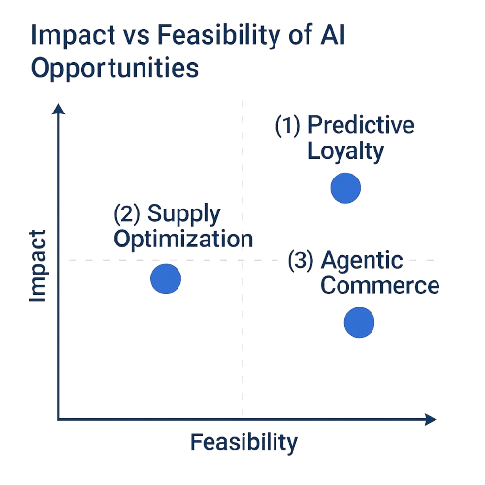
Strategic AI Opportunities for Walmart
Predictive Loyalty & Personalization
Intelligent Supply Optimization
Agentic Omnichannel Commerce
Tailored offers and dynamic rewards
Real-time availability, faster delivery
Seamless AI shopping across channels
Customer
Value
Business
impact
Stronger loyalty, higher retention
Fewer stockouts, better CX
Higher conversion and engagement

Slide 16

Threats

Slide 17
An Analysis Through Porter's Lens
Rivalry Among Competitors
Bargaining Power of Buyers
Threat of Substitutes
The AI Arms Race in Retail
Competition is no longer just about price and scale; it's an AI capability battleground.
Amazon:
Uses generative AI for personalized product descriptions and recommendations.
AI-powered summarization of product reviews helps customers make decisions faster.
Walmart's Response:
Launched generative AI search for use-case queries (e.g., "football watch party items").
Investing in AI-powered replenishment, AR shopping tools, and advanced semantic search to improve relevance.
The Empowered Consumer
AI has elevated buyer expectations and reduced the friction of switching between retailers.
Raised Expectations: Customers now expect hyper-personalized experiences as a baseline. They want retailers to "know them."
Increased Transparency: AI-powered tools allow consumers to compare offerings across multiple retailers almost instantly.
Low Switching Costs: A subpar or generic experience can immediately lead a customer to a competitor with just a few clicks.
New AI-Native Shopping Models
Emerging models threaten to bypass traditional retail entirely by integrating shopping into other experiences.
Quick-Commerce (Instacart): AI tools like "Ask Instacart" bridge inspiration and purchase in a single, seamless flow, reducing reliance on retailer websites.
Social Commerce (TikTok Shop): AI-curated video feeds embed products directly within content, capturing discovery, intent, and checkout all within the same app.

Slide 18
Strategic Implications
To counter these threats, Walmart can focus its AI investments in these key areas:
AI-Optimized Operations & Fulfillment:
01
03
Scale advanced search systems to reduce friction.
Expand route optimization and smart replenishment to maintain a cost advantage with faster delivery.
AI-First Customer Experience & Personalization:
Ecosystem & Substitute Integration:
Enhance generative search and recommendation engines to match Amazon's relevance.
Use customer data to dynamically tailor content and offers.
Partner with or integrate into quick-commerce and social platforms.
Invest in "agentic commerce" (AI assistants that shop for users) to stay ahead of the curve.
02
A Three-Pronged AI Strategy for Walmart

Slide 19
Expertise vs Competition
Conclusion
Strengths Vast customer and data scale enabling deep AI-driven personalization. Strong omnichannel AI integration enhancing unified CX and efficiency. Advanced tech ecosystem (Walmart Connect + Global Tech) driving closed-loop innovation and revenue growth. |  | Weaknesses Fragmented AI adoption focused more on operations than customer experience. Limited personalization and weaker app experience versus Amazon and Target. Stockouts, checkout delays, and inconsistent omnichannel CX frustrate users. Data silos, legacy systems, and cautious culture slow AI transformation.
Opportunities Rising consumer acceptance of AI shopping creates strong growth potential in personalized retail experiences. Global AI best practices show clear pathways for Walmart to enhance CX through predictive loyalty, conversational commerce, and intelligent automation. High-impact AI use cases predictive personalization, supply optimization, and agentic omnichannel commerce can strengthen loyalty and drive higher engagement. |  | Threats Intense AI-driven rivalry from Amazon, Target, and quick-commerce players raising CX and innovation benchmarks. Empowered customers with high personalization expectations and low switching costs intensify competitive pressure. Emerging AI-native shopping models (quick-commerce, social commerce) threaten to bypass traditional retail channels.
S
W
O
T

Slide 20
References
About Amazon. (2024). How Amazon is using generative AI to improve product recommendations and descriptions.
Instacart Company Blog. (2023). Bringing inspirational, AI-powered search to the Instacart app with Ask Instacart.
Microsoft Official Blog. (2024, January 9). Walmart unveils new generative AI-powered capabilities for shoppers and associates.
TechCrunch. (2024, January 9). Walmart debuts generative AI search and AI replenishment features at CES.
TikTok Newsroom. (2023). Introducing TikTok Shop in the US.
Walmart Corporate News. (2024, March 14). Walmart Commerce Technologies launches AI-powered logistics product.
Walmart Corporate News. (2024, October 9). Walmart reveals plan for scaling artificial intelligence, generative AI, augmented reality and immersive commerce experiences.
CNBC. (2024). Walmart Connect AI-driven ad revenue and personalization.
arXiv paper. (2024). Semantic Retrieval at Walmart.
TechCrunch. (2024). Walmart generative AI search debut at CES.
Walmart Corporate. (2025). Walmart unveils new AI-powered tools to empower associates.
TechCrunch. (2023). Walmart generative AI tools for planning and interior design.
Consumers are satisfied with supermarkets, but digital cracks emerge
ACSI® Retail and Consumer Shipping Study 2025
Sam's Club beats Costco – thanks to tech
McKinsey & Company. (2024). LLM to ROI: How to scale generative AI in retail. McKinsey & Company.
eMarketer. (2025, March 19). Over half of US consumers intend to use generative AI when shopping online this year. Insider Intelligence.
eMarketer. (2025, February 11). Shoppers are growing more comfortable with generative AI. Insider Intelligence.
eMarketer. (2025). Retailers race to deploy AI tools ahead of holiday surge. Insider Intelligence.
eMarketer. (2025). Walmart inks partnership with OpenAI to sell products through ChatGPT. Insider Intelligence.
eMarketer. (2025). What the rise of GenAI assistants means for retail media. Insider Intelligence.
Deloitte. (2025). How Agentic AI is transforming commerce and payment. Deloitte US.
McKinsey & Company. (2025). From blueprint to breakthrough: How AI and automation can transform the consumer enterprise. McKinsey & Company.

Slide 21
Thank You

